Slide 1
SMART CONTROL OF TRAFFIC LIGHTS USING ARTIFICIAL INTELLIGENCE M YAMINI SARASWATHI-160122737149 R KRISHNAVENI-160122737157 V VAISHNAVI DEVI-160122737165 P VISISHTA-160122737167 UNDER THE GUIDANCE OF: Mr. B. Harish Goud Assistant Professor IT Department

Slide 2
AGENDA
ABSTRACT
INTRODUCTION
LITERATURE SURVEY
EXISTING SYSTEM
PROBLEM STATEMENT
PROPOSED SYTEM
RESULTS
CONCLUSION
REFERENCES

Slide 3
ABSTRACT
Our lives have been made easier by the swift advancement of scientific advances across all domains, yet the road traffic accidents have increased over time and claimed countless lives. The average commute time in India's main cites has increased dramatically during rush hour. The typical traffic signal runs on a constant stream of instructions that are kept in memory. For over ten years, traffic control has been a challenge, and it will likely remain so for some time to come. In this system vehicle density at an intersection is measured and a signal switching algorithm is used to measure the proper time for the duration of the green and red lights, as well as the length of the vehicles waiting in each route at the intersection and also the next intersection to ensure a smooth flow of traffic.

Slide 4
INTRODUCTION
Current traffic system causes congestion and accidents due to static
signal timers.
Congestion leads to fuel waste, pollution, and economic impact.
Proposed AI-driven traffic lights adapt to real-time traffic density.
AI aims to improve flow, reduce congestion, and enhance safety.
Objectives include optimizing flow, adapting to patterns, and enhancing safety.

Slide 5
LITERATURE SURVEY
PAPERS | YEAR | OUTCOMES
INTELLIGENT TRAFFIC LIGHT SYSTEM USING IMAGE PROCESSING | 2021 | The system identifies cars using video cameras and employs an algorithm to count vehicles on the road via image processing. High-angle cameras at crossings capture traffic images, transmitting signals to a central server for real-time traffic density analysis.
AI DRIVEN TRAFFIC LIGHTS | 2023 | Proposed methodology is implemented using simulation of signals.Uses raspberry Pi for image processing and run smart algorithm
ARTIFICIAL INTELLIGENCE BASED FRAMEWORK FOR EFFECTIVE PERFORMANCE OF TRAFFIC LIGHT CONTROL SYSTEM | 2021 | Used for Detection of number of vehicles

Slide 6
PROBLEM STATEMENT
The primary cause of congestion is the extensive use of cars, whose ownership has increased dramatically in urban areas in recent years.
Because there are fewer cars than anticipated, a lot of time is lost at traffic signals.
We frequently have to stop at each traffic signal as we drive through a series of them.
Movement of Traffic not only result in an additional delay but also raise transportation expenses and fuel consumption.

Slide 7
EXISTING SYSTEMS
Manual Controlling :- As the Name Suggests That's requires More Man Power to control Traffic and Traffic Police is allotted to each traffic signals and they have to control traffic.
Automatic Controlling :- Automatic Traffic Light is Controlled by the timer and electrical Sensors. The Light are getting automatically Getting ON and OFF.
Electronic Controlling :- In Electronic Controlling Method We have To placing some detector or sensors on the traffic area, and this sensors give data about the traffic Density and control the traffic signals.

Slide 8
DRAWBACKS OF CUSTOMARY SOLUTIONS
The Manual Controlling System is static and requires a large number of manpower.
They May cause a delay in the quick movement of traffic.
Electronic Sensors and detector are very expensive in cost, accuracy and coverage are often in conflict.

Slide 9
STEP BY STEP FLOWCHART OF PROPOSED SYSTEM
Detecting vehicles and calculating traffic density
Calculating green signal time based on density
Time is scheduled at the server
Traffic Signal Timer is updated

Slide 10
PROPOSED SYSTEM
A . Calculating Vehicle Density
The function set_Time() adjusts signal timings based on vehicle quantity and type at the subsequent signal.
It initializes variables to count different vehicle types (cars, buses, trucks, rickshaws, bikes).
Counts for each vehicle type are incremented as vehicles are cycled through.
Total time for green signal is computed considering counts of vehicle categories.
Average time for each vehicle type to pass intersection is factored into the computation.
Debugging feature prints the computed green time for each signal change cycle.

Slide 11
B.Signal Switching Algorithm
Intersection features multiple signals cycling through green, yellow, and red phases.
Green allows movement in its direction; others remain red for safety.
Yellow signals upcoming changes, preparing for the next green phase.
Signal timing regulated by predefined parameters like default_Red, default_Yellow.
Algorithm considers processing time, lane count, vehicle volume, and traffic density.
Preset sequence maintains order, minimizing confusion for drivers.

Slide 12
C. Simulation
Pygame used to create real-world traffic simulation for enhanced visualization.
Four-way stop simulation includes timers at each signal for signal changes.
Variety of vehicles such as cars, motorbikes, buses, trucks, and rickshaws included.
Some far-right lane vehicles turn at intersection to mimic real-life scenarios.
Random numbers used in vehicle construction for increased variability.
Timers on vehicles display elapsed simulation time for monitoring.

Slide 13
ADVANTAGES OF PROPOSED SYSTEM
Autonomous: There are no need of the Manpower
Dynamic System, Manages Traffic light switching according to current traffic density.
Less expensive than other solutions.
There are no need to new hardware to be installed.

Slide 14
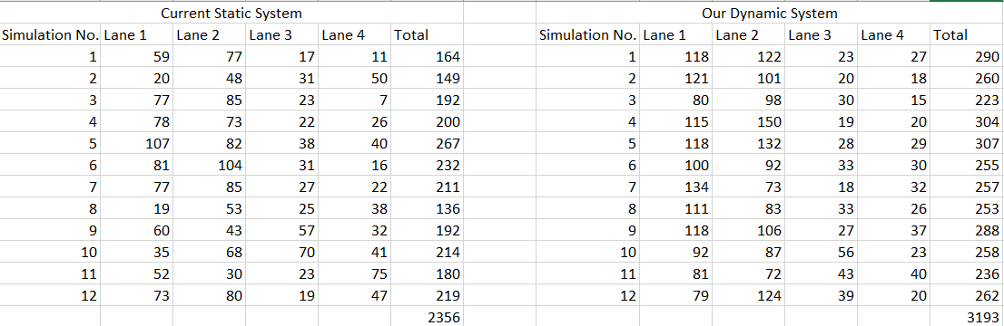
RESULTS
A total of 12 simulations were carried out, each lasting for 5 minutes.

Slide 15
Our implemented system could pass 3193 vehicles in an hour compared to 2356 vehicles in the static system, which is an increase of 837 vehicles.
This translates to an increase in performance by 35% of the AI enabled traffic light system.
On an average 70 more vehicles can pass in every simulation

Slide 16
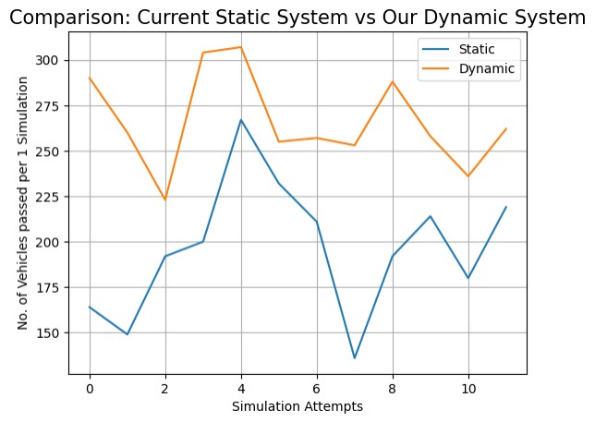

Slide 17
CONCLUSION
Using the dynamic model we can effectively reduce the waiting time of the vehicles.
Our proposed Traffic management system with AI improves the performance by over 35% comaparing to Current System.
Using the AI model adds an additional functionality to reduce the waiting time of vehicles at their next crossing.
Both of these can be implemented using edge computing at the traffic signal itself.
It can be implemented with effectively with very little cost.

Slide 18
REFERENCES
[1] Anuj Singh, Sachin Sharma, Kamlesh Chandra Purohit, Nithin Kumar K C, “Artificial Intelligence Based Framework For Effective Performance Of Traffic Light Control System”
[2] K.D.S.A. Munasinghe, T.D. Wanththegedara, I.R. Wickramasinghe, H.M.O Herath, V.Logeeshan, “Smart Traffic Light Control System Based On Traffic DensityAnd Emergency Vehicle Detection”
[3] Mihir M.Gandhi, Devansh S.Solanki, Rutwij S. Daptar, Nirmala Shinde Balookar, “Smart Control Of Traffic Light Using Artificial Intelligence”
[4] S.S Zia, M.Mala, M.Tahir, T.J.A. Mughal, T.Mubeen, “Smart Traffic Light System By Using Artificial Intelligence” [5] P.Shamugapriya, Kaheboya Hari Shankar,Kandikattu Mallikarjuna, “Smart Control Of Traffic Light Using Artificial Intelligence”

